Slide 1

I. Android Internals

Slide 2
Android platform
Android is a Linux-based operating system and a software stack designed for mobile devices
Key Applications Home, Phone, Browser
Application Framework Java layer system services
Middlewares Libraries, Dalvik VM
Operating system Linux kernel

Slide 3


Android platform
Developed by Google*
  2005 – purchased Android Inc
  2007 – established Open Handset Alliance (OHA)
  2012 – Oracle v. Google on Java API
Compatibility Definition Document to certify devices | SDK + tools to create applications

Slide 4
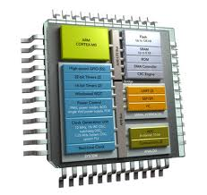
Android platform
Main hardware platform for Android is ARM
  support for x86 from the Android x86 project
Advanced RISC Machine
  7.9 billion shipped in 2011
    95% smartphones
    90% hard disk drives
  Reduced instruction set computing (RISC)
  Lower costs, Less heat, Less power usage
  Reduced complexity and simpler design
  Good interfacing to many devices

Slide 5
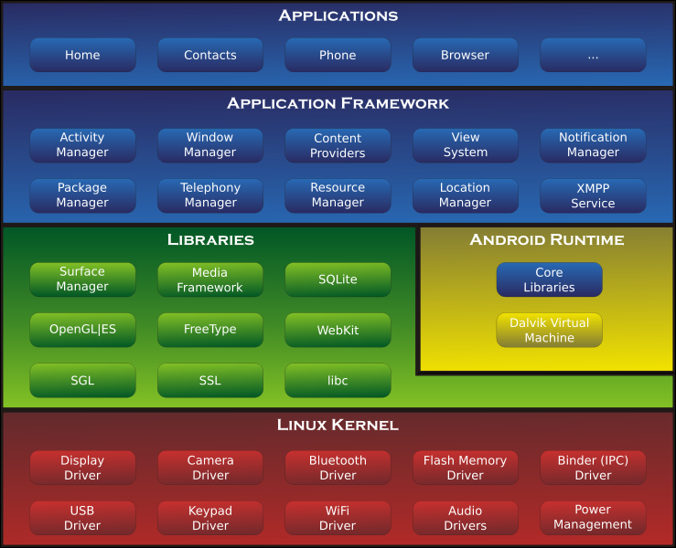
Android Anatomy

Slide 6

Android Linux Kernel
Android kernel based on Linux 2.6 and 3.x (Android 4.0)
Why Linux?
  Great memory and process management
  Permissions-based security model
  Proven driver model
  Support for shared libraries
  Open source

Slide 7


Android Linux Kernel
Android “is not Linux”
  Users never see Linux sub system
  Not the full set of standard Linux utilities
  August 2011, Linus Torvalds - "eventually Android and Linux would come back to a common kernel, but it will probably not be for four to five years"

Slide 8

Android Linux Kernel
Android patch of kernel enhancements
  Power Management
  Ashmem
  Binder IPC
  Low Memory Killer
  December 2011 - Android Mainlining Project to put some Android drivers, patches and features back into the Linux kernel

Slide 9
Android Native Libraries

Slide 10

Android Native Libraries
Bionic Libc
  Fast and small, license-friendly, optimized for mobile
Function Libraries
  WebKit, Media Framework, SQLite
Native Servers
  Surface Manager, Audio Manager
Hardware Abstraction Libraries
  WiFi, Bluetooth, GPS, Camera

Slide 11
Android Runtime

Slide 12

Android Runtime
On Android you develop in Java
  ... but Android does not run Java Bytecode !

Slide 13

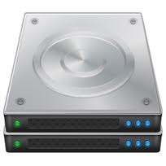
Android Runtime
Custom Virtual Machine. Why?
Constraints Designed for 64M RAM No swap Phone tech v. Desktop CPU specific | Oracle JVM problems Memory Hog Slow startup IP licensing restrictions

Slide 14

Android Runtime
Dalvik Virtual Machine
  Custom VM optimized for mobile devices
  Register-based JVM
  More efficient and compact
  Use memory efficiently
  Dalvik Executable Code (.dex)
    30% fewer instructions
    35% fewer code units
  Trace JIT compiler (since 2.2)

Slide 15
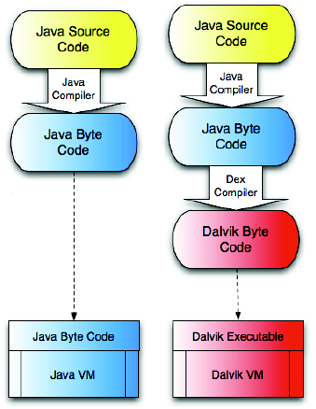
Android Runtime
Android Java = Java language + Dalvik + Apache Harmony
Android Java API = Java SE – AWT/Swing + Android API
Sun-Java = Java language + JVM + JDK

Slide 16
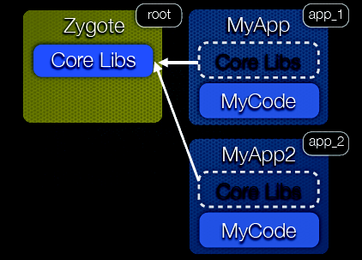
Android Runtime
Zygote spawns VM processes
  Already has core libraries loaded
  When an app is launched, zygote is forked
  Fork core libraries are shared with zygote
  Solves HotSpot start-up performance and memory problems

Slide 17
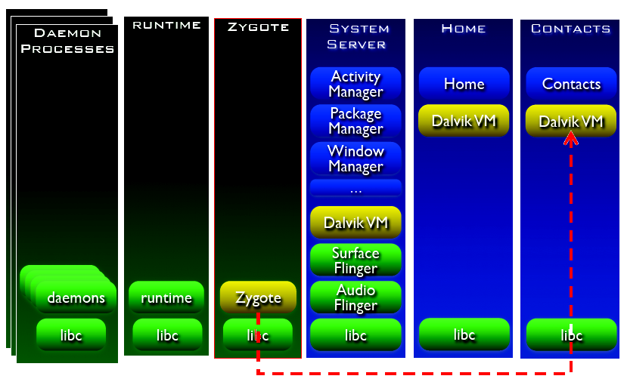
Android Runtime

Slide 18
Android Runtime

Slide 19
Android Runtime
Core libraries
  Core APIs for Java language (IO, Structures, ...)
Core Platform Services, Application Framework
  Activity Manager, Package Manager, Window Manager, Resource Manager, Content Providers, View System
Hardware Services
  Telephony, Location, Bluetooth, WiFi, USB, Sensor

Slide 20

II. Android Developer Toolchain

Slide 21
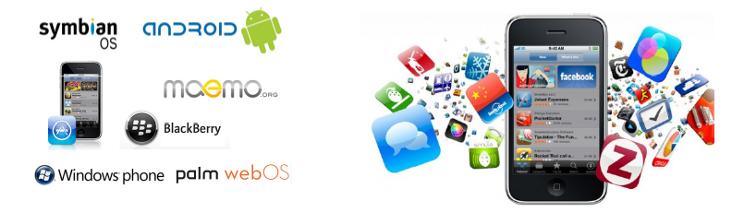
Android offer
The first open* and comprehensive platform for mobile devices
  an operating system, user-interface and applications
  a mobile phone without the proprietary obstacles that have hindered mobile innovation
  an open-source development platform

Slide 22

Android offer
Apps are equivalent parts of the phone using the same API
Reuse and replacement of application components
GSM, EDGE, 3G, 4G, LTE data transfer
Comprehensive location-based APIs
Wi-Fi hardware access and peer-to-peer connection

Slide 23

Android offer
Full multimedia hardware control, media libraries
APIs for sensor hardware
Libraries for Bluetooth and NFC
Shared data stores and APIs for contacts, social networking
Background Services, applications, and processes
Home-screen Widgets and Live Wallpaper

Slide 24

Android Developer Challenge
A developer challenge Google hold every year for Android mobile platform
Demonstrates the capabilities of Android platform
Developers submit their apps to one of 10 specially-designated ADC categories
Top 20 applications in each category will proceed to the second round
Community vote constituting 40% of the final judging score

Slide 25
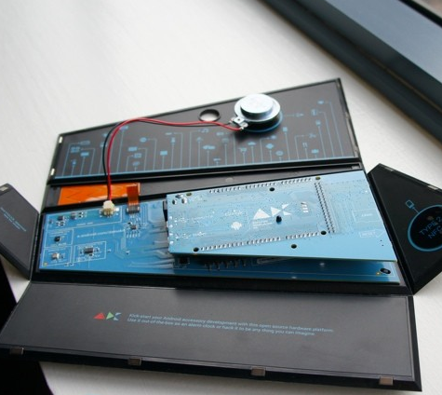
Accessory Development Kit
RI for building accessories for Android
Source code and hardware specifications
ADK 2012 is based on the Arduino open source electronics prototyping platform

Slide 26


Install Android
What do we need for Android?
Android SDK
ADT (Android Developer Tools)
AVD (Android Virtual Device)

Slide 27

Android SDK
Android APIs
  Developer access to the Android stack
Development tools
  Compile and debug your applications
Android Virtual Device Manager
Emulator
Documentation
Sample code

Slide 28
Android SDK
http://developer.android.com/sdk (Linux, Mac OS X, Windows)
Installation Option1: SDK Tools Only
  Initially contains only the basic SDK tools
  Need to install the Platform-tools and Android platform(s)
Installation Option2: ADT Bundle
  Eclipse + ADT plugin
  Android SDK Tools
  Android Platform-tools
  The latest Android platform
  The latest Android system image for the emulator

Slide 29
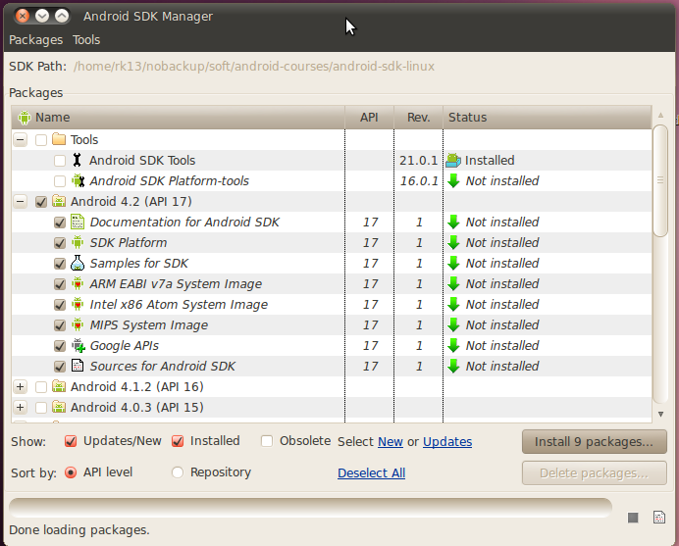
Android SDK
SDK Manager.exe (Windows) v. tools/android (Mac, Linux)

Slide 30
Android SDK
SDK packages
<sdk>/tools/ | Tools for debugging and testing, utilities to develop an app (sdk manager, ddms, emulator)
<sdk>/platform-tools/ | Platform-dependent tools for developing, support latest features of the Android platform and are updated with new platform (adb, fastboot, aapt)
<sdk>/docs/ <sdk>/sources/ | Latest documentation for the Android APIs
<sdk>/platforms/ | a) SDK Platform for each version of Android, android.jar with a fully compliant Android library b) System images for Android emulator
<sdk>/add-ons/ <sdk>/extras/ | Special APIs and static libraries you can include in your app sources in order to use powerful APIs that aren't available in the standard platform

Slide 31




Android Development Tools
Eclipse plugin
Professional-grade development environment
Free, open-source, and runs on most major OS
Provides the emulator

Slide 32
Android Development Tools
Tooling
  Wizard for creating new project
  WYSWYG UI Designer
  Code / XML editor
Integrated with
  AVD Manager
  DDMS

Slide 33
ADT Installation Options
ADT Bundle
  provides everything you need to start - Eclipse IDE with built-in ADT
  Eclipse Juno Release
Existing IDE
  Download ADT plugin
    Help > Install New Software.
    Add Repository
    https://dl-ssl.google.com/android/eclipse/
  Configure ADT plugin

Slide 34
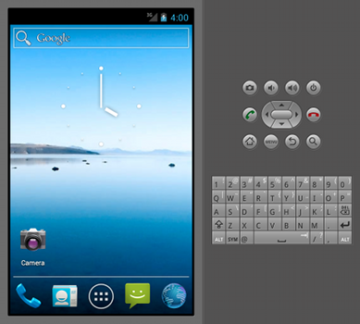
Android Emulator
QEMU-based
Same image as on device
Same toolchain to work with device or emulator
Mimics all of the hardware and software features of a typical mobile device
Startup may be slow, try “Graphics Acceleration” and “Virtual Machine Acceleration”, or use a device instead

Slide 35
Android Virtual Device
Android Virtual Device (AVD) is an emulator configuration to model an actual device by defining hardware and software options
  Hardware profile - hardware features (camera, physical, memory)
  Mapping to a system image - version of the Android platform will run on the virtual device
  Dedicated storage area - the device's user data, emulated SD card
  Other options - emulator skin, emulated SD card

Slide 36
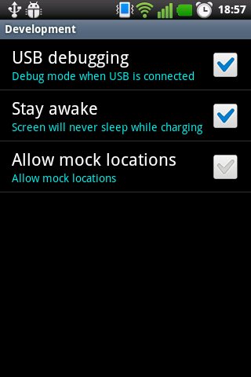
Develop on Hardware Devices
Use any Android hardware device
Deploy your app to connected devices directy from the IDE
Live, on-device debugging, testing, and profiling
Enable debugging over USB
Developer options in the system Settings

Slide 37

Dalvik Debug Monitor Server (DDMS)
Works with both the emulator and a connected device
Capabilities
  Heap usage for a process
  Track memory allocation of objects
  Work with an emulator or device's file system
  Examining thread information
  Network Traffic tool (Android 4.0)
  LogCat

Slide 38
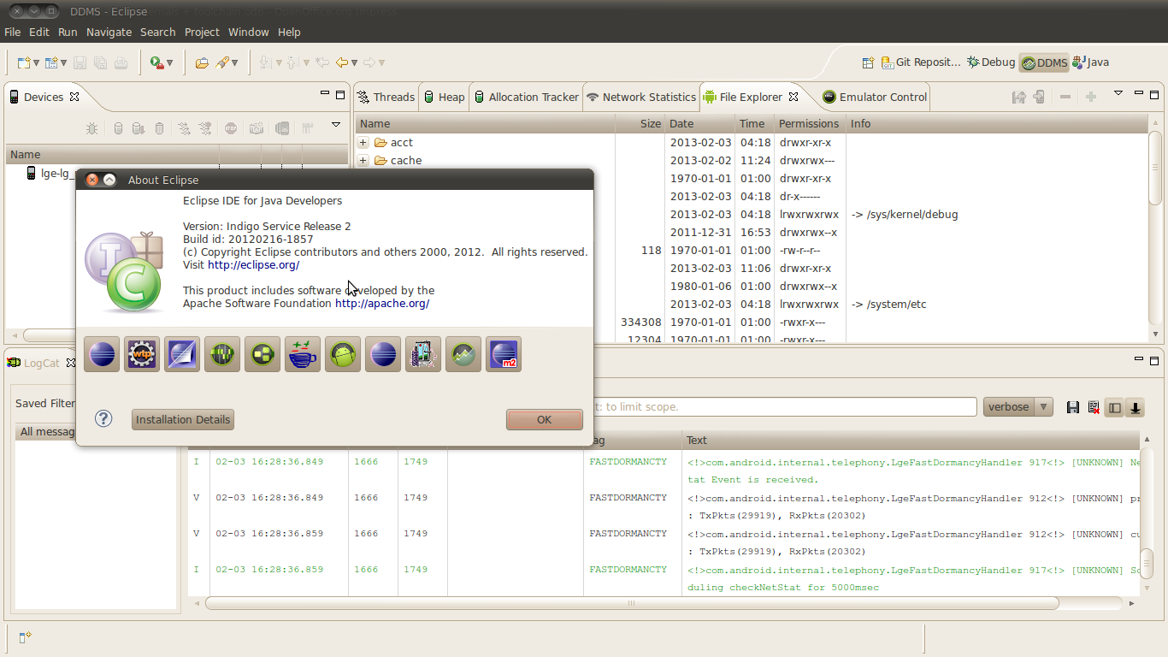
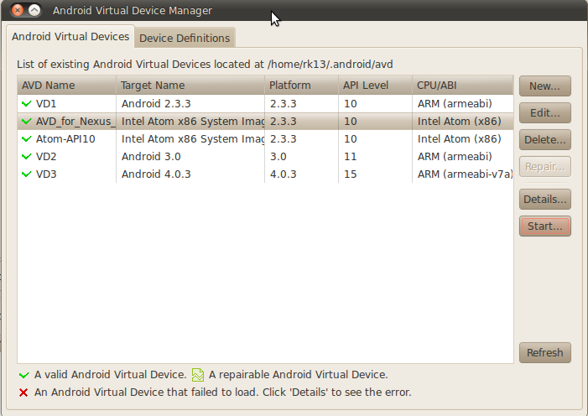
DEMO

Slide 39
Usefull SDK utilities
Android Debug Bridge (adb) | Command line tool to communicate with an emulator instance or device (client, server, daemon) Important commands: - devices – show device list - install – install application file - pull / push – copy files to/from device - logcat - print log data - shell – start remote shell on device
Android Device Monitor (monitor) | Tool for Android application debugging and analysis without ADT
Hierarchy Viewer (hierarchyviewer) | Debug and optimize your user interface. Visual representation of the layout's View hierarchy
ProGuard | Obfuscates your code

Slide 40

Native development kit (NDK)
If the speed and efficiency of C/C++ is required
Tools to build and compile your native code for the device architecture
A way to package your library into the APK file to distribute your application easily
A set of native system headers supported for Android platform (libc, libz, liblog, JNI headers)
Documentation, samples

Slide 41
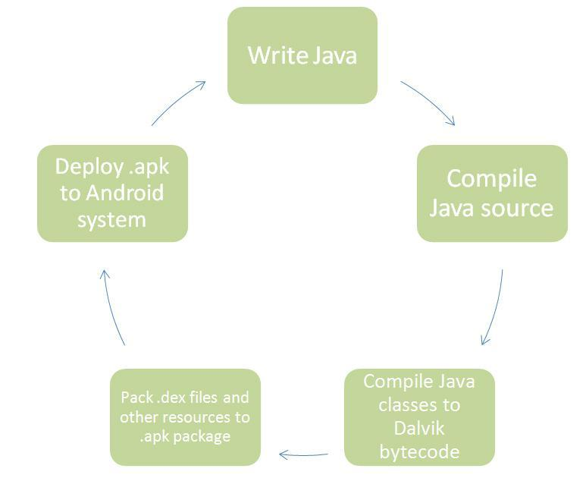
Application creation cycle

Slide 42
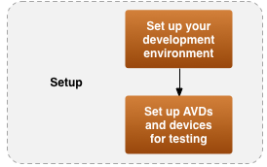


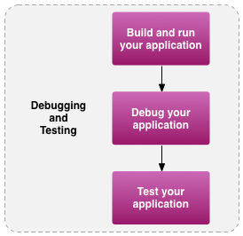
Hello, world ... finally
DEMO

